Slide 1
CIS 475 Course Course Project Team # ___________
Step 0.1. Report Team members: Suraj Swaroop (475) Terrence Pledger (11)

Slide 2
CIS 475/575 Course Project: Type of Selected Client (company, organization) and Client’s Main Business Functions
Provide below details on selected client (company, organization):
Sinclair Community College
Dayton, Ohio
https://www.sinclair.edu/
Education
Client’s Main Business Functions (at least 10):
Profit
Commitment to affordable services
Educating individuals
Athletic training (Baseball, Football, Track, etc)
Research and Development
Provide facilities to encourage pursuit of education
Provide facilities for wellbeing of students and staff
Improve student retention
Sponsored Research (grants, contract, etc)
Business Expansion
-
-
-
-
-
-
-
-
-

Slide 3
CIS 475/575 Course Project: 10 Identified CIS systems to support Client’s Main Business Functions
Provide below details about identified CIS systems:
CIS # 1: Academic Analysis – This system can help the university make decisions based on their various academic statistics
CIS # 2: Student and Faculty Database – These databases keep track of enrolled students and the professors in order to show grades, schedules, etc.
CIS # 3: Class Database – The class database stores the various classes to display them in an organized fashion
CIS # 4: Payroll CIS – System to organize and manage payments to the different staff members or students that work on campus
CIS # 5: Large Scale Website– Website to promote the university and increase engagement
CIS # 6: ERP System – System for tracking and managing university resources or supplies
CIS # 7: HR System – A system specifically for maintaining staff information
CIS # 8: Learning Management System – System for students to interact with university functions (signing up for classes, looking at grades, etc.)
CIS # 9: Online Library – System for students to view available university books
CIS # 10: B2B System – System to expedite business transactions for university supplies/resources (such as library books)

Slide 4
CIS 475/575 Course Project: Selected type of CIS system (XYZ domain) for further in-depth analysis, design and development
Provide below a justification of your selection of one CIS system for in-depth analysis, design and development:
(A hint: this selected one CIS must be from lists of Advanced, Regular or Traditional CIS systems – see CP assignment).
It is interesting to view the different factors that would go into making decisions based off of academic statistics in a university
2. What kind of tangible and intangible benefits will be provided by that selected CIS for your client?
Expected Tangible Benefits:
Increased student academic success
Increased student retention rates
Increase in overall profit
Expected Intangible Benefits:
Better student morale
Informed decision making
More demographics and statistics for the university

Slide 5
(If needed, add here the additional slides to increase quality of your course project outcomes)

Slide 6
Project Analysis Phase: Analysis of 10 U.S. Top Systems in Academic Analytics
7-10 main functions of this CIS:
1) AcademicAnalytics.com
2) Baylor University Benchmarking System
3) ECU (East Carolina University) Data Portal
4) DataDoubles.org
5) OklahomaAnalytics.com
6) TheTableau.com
7) HivePacific.com
8) Insight-centre.org
9) Reedtech.com
10) Thoughtspot.com

Slide 7
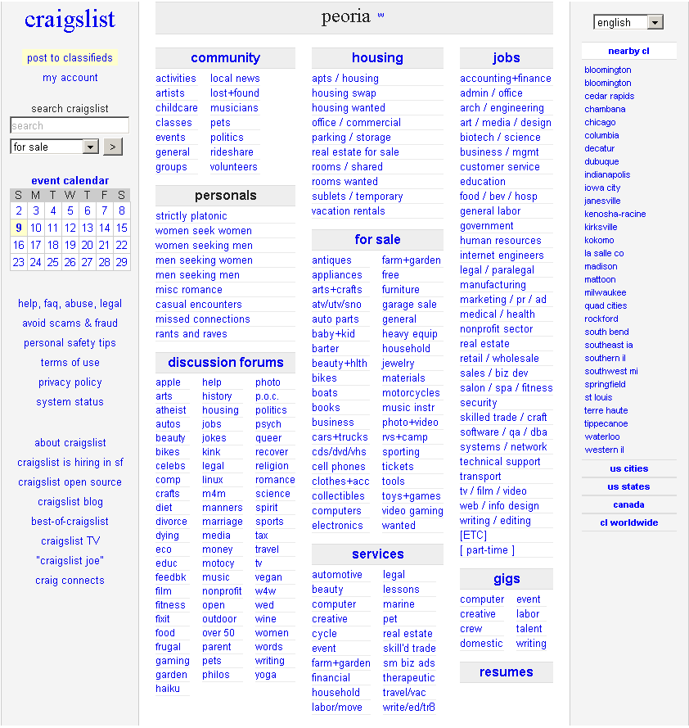
AcaedmicAnalytics.com in domain: Academic Analytics
7-10 main functions of this CIS:
1) Georgetown faculty analysis
2) US Department of Education
3) Elsevier.com
4) Microsoft Academic Analytics
5) Google Analytics
6) Tableau Analytics
7) Apple Academic Press
Source: AcademicAnalytics.com

Slide 8
Thank you!

